Slide 1







Verb Tense

Slide 2


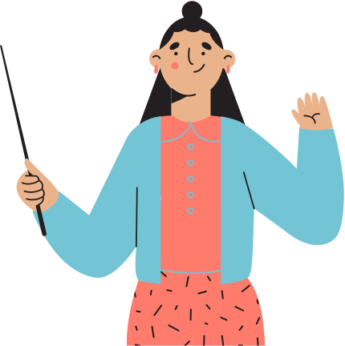

tells us when the action in a sentence takes place
most verbs take a past, present, or future tense
the verb may change forms to reflect:
something that already happened
something that is currently happening or is an ongoing truth/reality
or something that will happen in the future

Slide 3



LET’S ANALYSE THIS SENTENCE:
The researcher explained the unusual results.

Slide 4

The researcher explained the unusual results.
past tense verb
THE PAST TENSES USE VERBS TO SAY THAT SOMETHING HAPPENED IN THE PAST, I.E., ANYTIME BEFORE THIS MOMENT RIGHT NOW

Slide 5
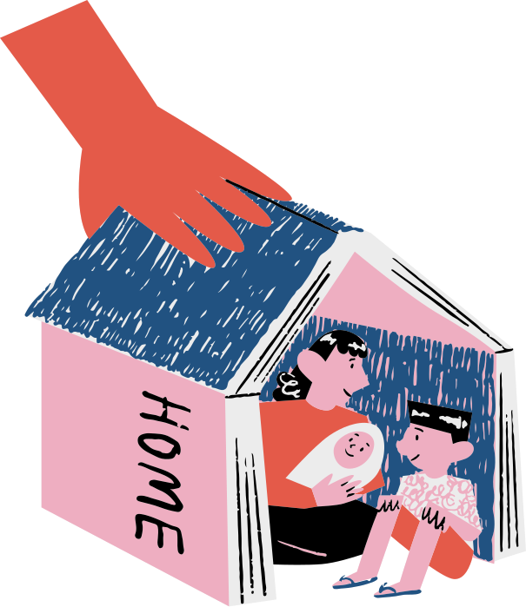
LET’S ANALYSE THIS SENTENCE:
Poverty exists in the world even to this day.

Slide 6
Poverty exists in the world even to this day.
present tense verb
THE PRESENT TENSES TELL US ABOUT EVENTS THAT ARE HAPPENING RIGHT NOW IN THE PRESENT TIME

Slide 7


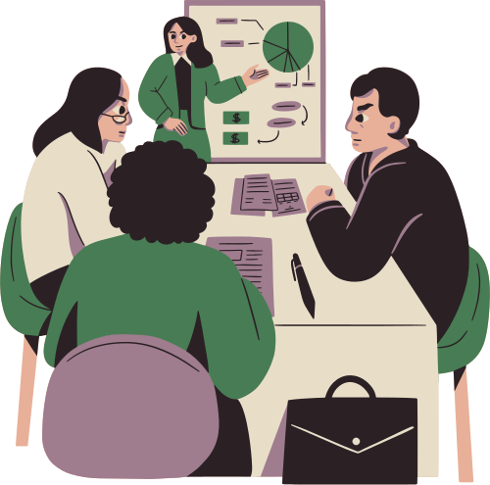
LET’S ANALYSE THIS SENTENCE:
This study will challenge entrepreneurs in their views of the current state of the economy.

Slide 8
This study will challenge entrepreneurs in their views of the current state of the economy.
future tense verb
the future tense requires the helping verb will
THE FUTURE TENSES TELL US ABOUT EVENTS THAT WILL HAPPEN SOMETIME IN THE FUTURE

Slide 9


LET’S ANALYSE THIS SENTENCE:
The goal of this study is to determine how the Armed Forces reacted to threats of war in the past and to implement strategies that will encourage proactive movements rather than reactive movements in the future.

Slide 10
SOMETIMES SENTENCES MIGHT HAVE MULTIPLE VERB TENSES:
The goal of this study is to determine how the Armed Forces reacted to threats of war in the past and to implement strategies that will encourage proactive movements rather than reactive movements in the future.
the first verb is in the present tense
the second verb is in the past tense
the third verb is in the future tense

Slide 11
WHY STUDY VERB TENSE?
Academic and professional purposes
Clear communication
Expressing timeframes
Proper understanding
Narrative structure
Conveying habits and routines
Avoiding confusion
Writing and speaking skills
Building fluency

Slide 12
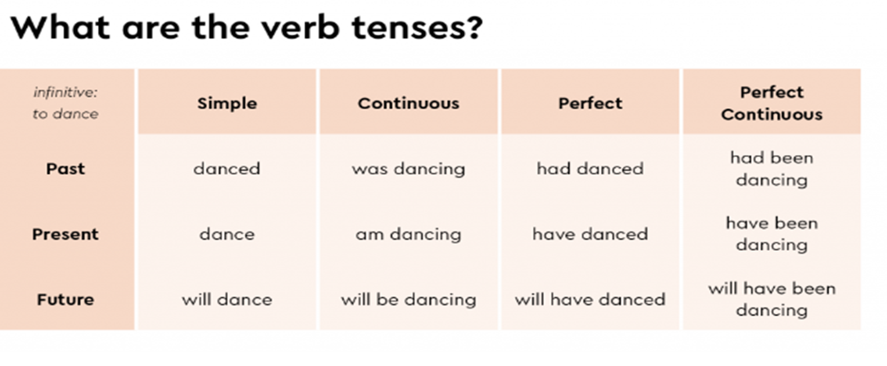

Slide 13

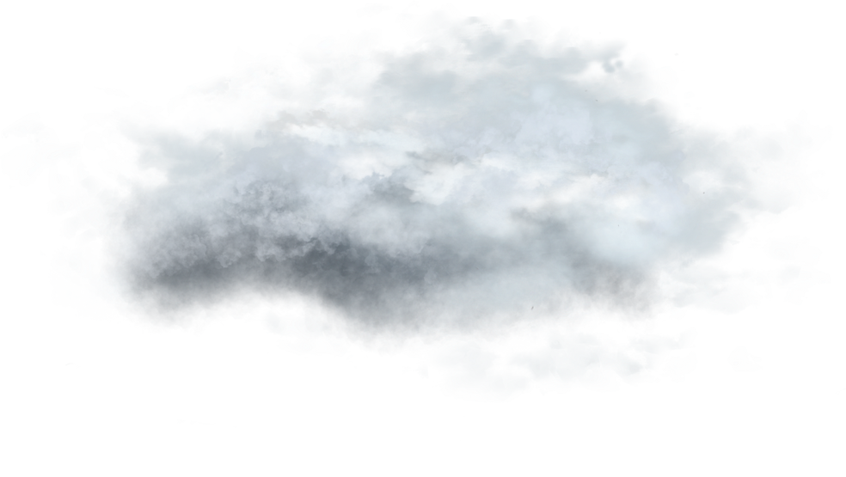



LET’S ANALYSE THIS SENTENCE:
Galileo observed the stars.

Slide 14
Simple Past Tense
Galileo observed the stars.
DESCRIBES EVENTS THAT BEGAN AND ENDED IN THE PAST

Slide 15



LET’S ANALYSE THIS SENTENCE:
The planet was moving along an elliptical orbit.

Slide 16
Past Continuous Tense
The planet was moving along an elliptical orbit.
DESCRIBES EVENTS THAT BEGAN IN THE PAST, CONTINUED FOR A LENGTH OF TIME, AND ENDED IN THE PAST

Slide 17


LET’S ANALYSE THIS SENTENCE:
The girl bought the telescope her teacher had recommended to her.

Slide 18
Past Perfect Tense
had recommended
(past perfect tense)
The girl bought the telescope her teacher had recommended to her.
bought
(simple past)
DESCRIBES A PAST EVENT THAT OCCURED (had recommended) BEFORE ANOTHER OAST EVENT (bought)

Slide 19

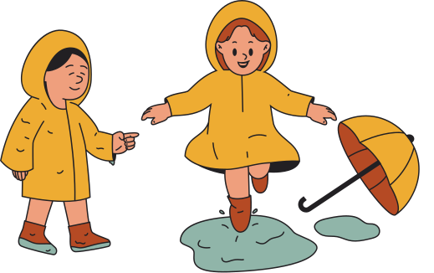
LET’S ANALYSE THIS SENTENCE:
It had been raining hard for several hours and the streets were very wet.

Slide 20
Past Perfect Continuous Tense
had been raining
(past perfect continuous tense)
It had been raining hard for several hours and the streets were very wet.
were
(simple past)
DESCRIBES AND EVENT THAT BEGAN IN THE PAST, CONTINUED FOR LENGTH OF TIME, AND WAS IN PROGRESS (had been raining) WHEN ANOTHER PAST EVENT HAPPENED (were)

Slide 21
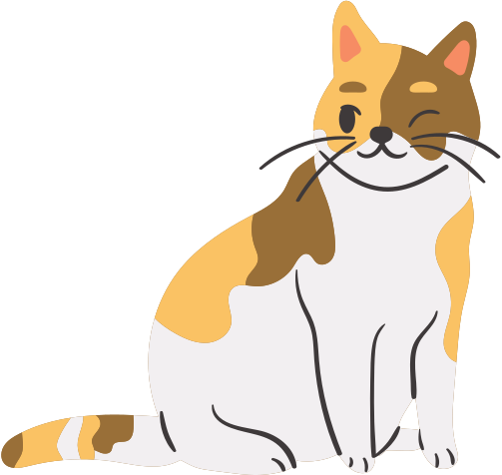
LET’S ANALYSE THIS SENTENCE:
Cats eat mice and birds.

Slide 22
Simple Present Tense
Cats eat mice and birds.
DESCRIBES AN EVENT AS HAPPENING IN THE PRESENT OR TO STATE FACTS

Slide 23


LET’S ANALYSE THIS SENTENCE:
The baby is laughing at Shelly’s monkey puppet.

Slide 24
Present Continuous Tense
The baby is laughing at Shelly’s monkey puppet.
DESCRIBES AN EVENT AS BEING IN PROGRESS IN THE PRESENT AND LIKELY CONTINUING INTO THE FUTURE

Slide 25

LET’S ANALYSE THIS SENTENCE:
The baby has played this game before.

Slide 26
Present Perfect Tense
The baby has played this game before.
DESCRIBES AN EVENT THAT OCCURED IN THE PAST BUT HAS SOME CONNECTION TO THE PRESENT

Slide 27

LET’S ANALYSE THIS SENTENCE:
Shelly has been babysitting for years.

Slide 28
Present Perfect Continuous Tense
Shelly has been babysitting for years.
DESCRIBES AN EVENT THAT BEGAN IN THE PAST BUT STILL CONTINUES TO HAPPEN IN THE PRESENT

Slide 29



LET’S ANALYSE THIS SENTENCE:
Molly will finish her chores when she has time.

Slide 30
Simple Future Tense
Molly will finish her chores when she has time.
DESCRIBES AN EVENT THAT WILL BEGIN AND END IN THE FUTURE

Slide 31
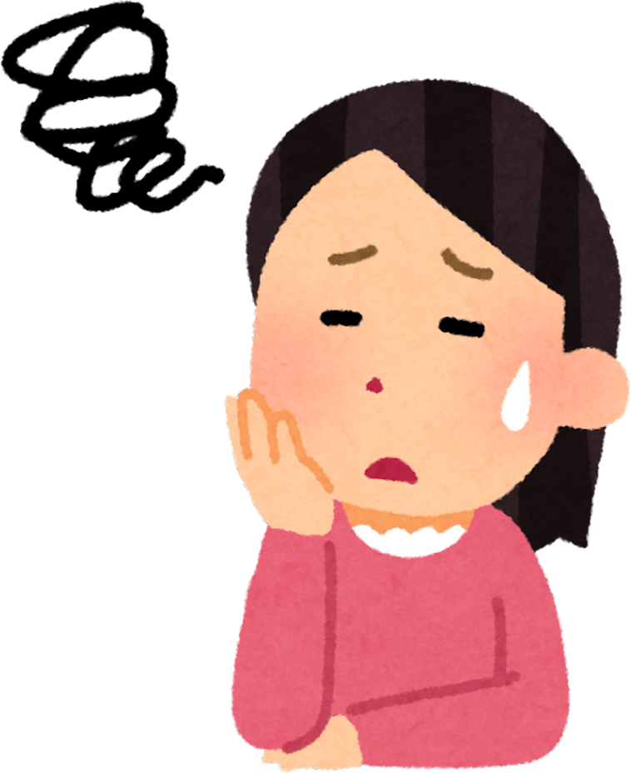
LET’S ANALYSE THIS SENTENCE:
I will be working all afternoon, so I can’t help Olivia with her report.

Slide 32
Future Continuous Tense
I will be working all afternoon, so I can’t help Olivia with her report.
DESCRIBES AN EVENT THAT WILL BEGIN IN THE FUTURE AND CONTINUE FOR A LENGTH OF TIME

Slide 33

LET’S ANALYSE THIS SENTENCE:
By tomorrow afternoon, Olivia will have finished her report.

Slide 34
Future Perfect Tense
By tomorrow afternoon, Olivia will have finished her report.
DESCRIBES A FUTURE EVENT THAT WILL HAPPEN BEFORE ANOTHER FUTURE EVENT

Slide 35
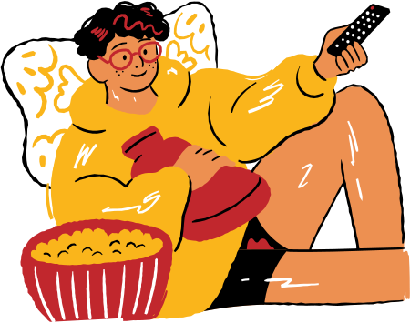
LET’S ANALYSE THIS SENTENCE:
When this show ends, Molly will have been watching TV for three hours.

Slide 36
Future Perfect Continuous Tense
When this show ends, Molly will have been watching TV for three hours.
DESCRIBES A FUTURE EVENT THAT WILL BEGIN, CONTINUE FOR A LENGTH OF TIME, AND STILL BE IN PROGRESS WHEN ANOTHER FUTURE EVENT OCCURS

Slide 37



